Slide 1
Planning with a Purpose –
Renewing Campus Resilience
NYAPPA
Winter Conference 2026
February 3, 2026

Slide 2
Learning Objectives:
Strengthen Strategic Alignment through a Unified Vision – Mission Execution: Executives will learn how to translate a unified institutional vision into coordinated mission – driven actions across assessment, prioritization, scoping, budgeting and execution systems.
Evaluate and Redesign Capital Renewal Processes using a Systems of Systems Approach: Executives will understand how to diagnosis gaps in the current capital renewal workflow an apply a systems approach to build a more consistent, reliable, and data-informed planning process.
Leverage Data, Metrics, and Learning Systems to Improve Decision Quality: Executives will be able to identify critical data elements (asset condition, space usage, academic viability, risk tolerance) and explore how analytics, dashboards, and knowledge management systems improve transparency, accountability, and strategic resourcing decisions.
Lead Adaptive Change Across Stakeholders and Organizational Boundaries: Executives will learn adaptive leadership practices for engaging diverse stakeholders; from college Deans and administrators, to central facilities planners and maintenance staff towards shaping a shared mental model that drives culture, collaboration, and continuous process improvement.

Slide 3
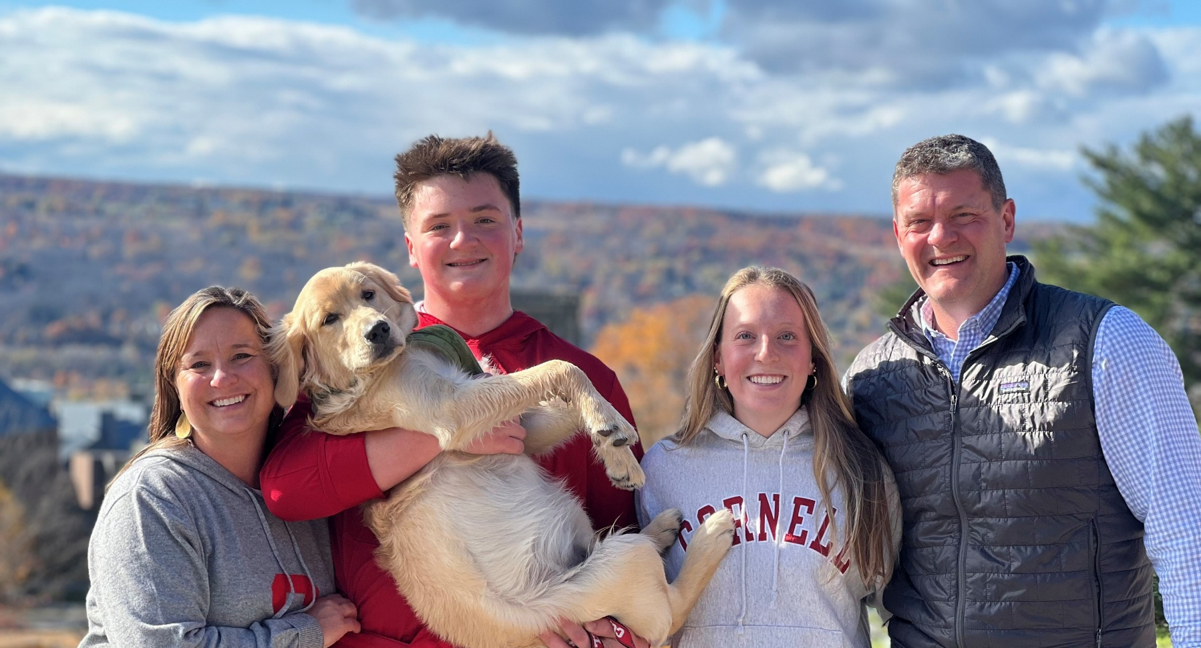
“A Germane” (A. Germain) Cornell Experience
Notes:
I have been a part of the Cornell Community for most of my life.
20 yrs this month I will have worked at Cornell. I present to you with a unique perspective of the Cornell Experience!
Employee
Engineer Building Envelopes
Director of Project Management
Director of Asset Management
Sr. Associate Director of Capital Renewal
Proud Parent
Remy – 2nd yr student in the College of Agriculture and Life Sciences – studying Agriculture Science
Beneficary of the New Visions program and Cornell’s outreach program with Tompkins, Seneca and Tioga County where see spent her entire Sr. year in a lab on campus studying different varieties of Tomatoe plants to resist salination and arid climates.
My son Harris is interested in Marine Biology and had an opportunity to go the Cornell Shoals Marine Lab for a week and learn about Vertebrates.
Student
Closing in on the mid point of my Executive MBA degree at Cornell University
Learning new technology, different case studies and developing new skills and strategies
Community Member
A fan of the Cornell athletics. I enjoyed watching the Cornell Lacrosse team win the national championship
My son has dreams to plan
My Dog Gus has participated had a visit or two to the Cornell Vet. “Growing Pains”
Engaging with faculty and staff within the community.
Alumni Community
Two siblings graduate from Cornell
Biology Department – studied gene mutations in fruit flies.
Engineering School – Designed a bridge as part of competition that was later built, some may have traveled over it on route one in Delaware over the Delaware Chesapeake Canal
Uncle introduced me to lacrosse in the 1980’s a player on the team and I was able to get a behind the scenes tour of the Vet School Open house.
All these experiences have made a huge impression on me and helped influence me and family.

Slide 4

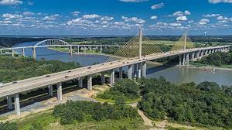
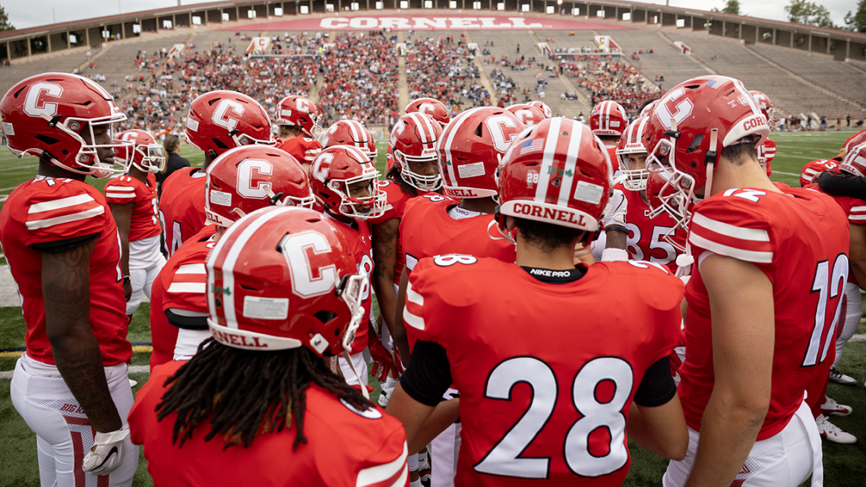
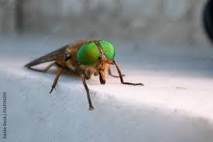

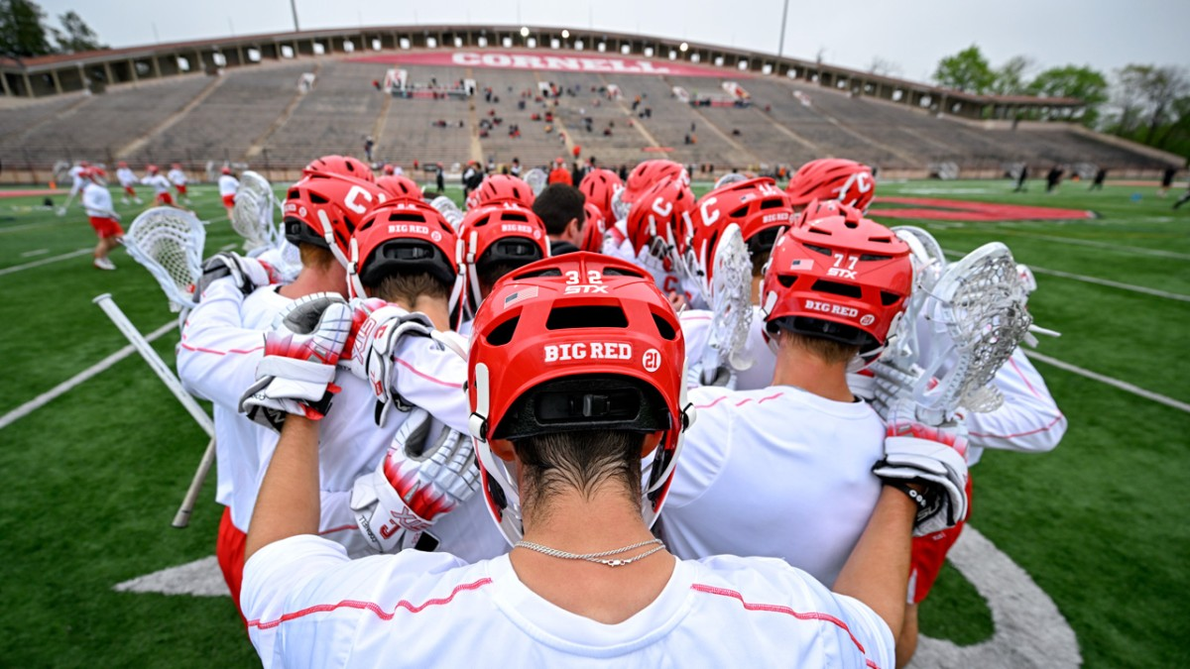
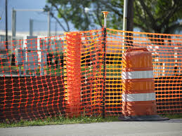
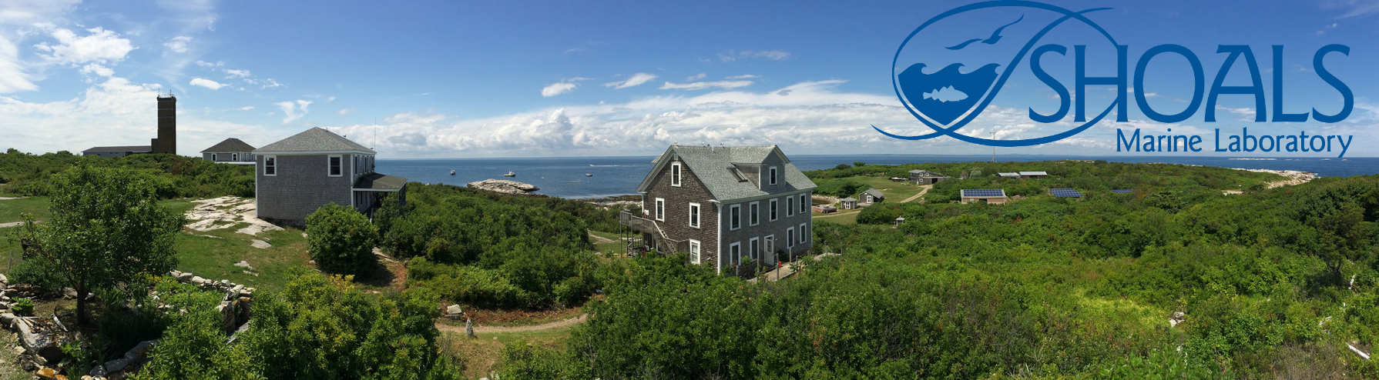

Cornell University’s Vision & Mission
“Any Person … Any Study...”
Teaching & Education
Research
Student Experience
Outreach
Notes:
Vision – of Ezra Cornell Any Person … Any Study….
Mission
Teaching & Education
Research
Student Experience
Outreach
Some things I remember through the years… my many visits lots of orange construction fence.
Hollister Hall in the ……
Bradfield Hall …
As a visiting Athlete the running out of hot water in the locker room a Schoelkopf stadium
Not much as changed in those facilities in the past 40 yrs….
But that has not hampered their impact…
These experiences are what make your institution special not the facilities. The facilities help inspire but are not the driving factor….

Slide 5
Capital Planning in Higher Education
“Capital Planning is higher education is the strategic process of forecasting, prioritizing, and budgeting for long-term investments in physical assets… … buildings, infrastructure, and technology to align with an institution’s educational mission and financial capacity.”
Academic
Infrastructure
Financial
What is missing from this definition and visual?
Culture!
Notes:
What is missing? Culture! What makes your campus so special. The culture is what drives the cur

Slide 6
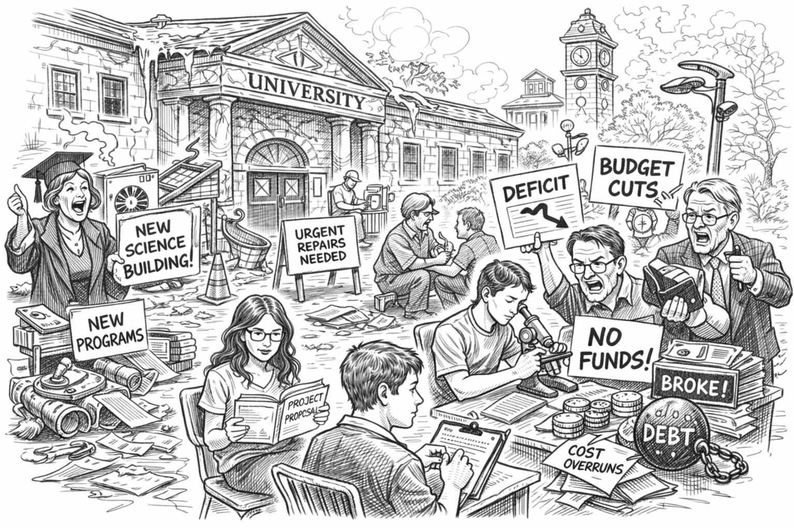
“Culture eats strategy for breakfast!” (P. Drucker)
Notes:
So why does it feel like this…..
Add financial Strain,,,to the image …
Physical, Data is possible
Academic … Subjective Data is a challenge
Financial ….
Challenge to think differently ….PCCU vs VMCL….
Traditional
Plan
Command
Control
Utilize
New
Vision,
Mission,
Capacity,
Learning – Builds Culture

Slide 7
Traditional Leadership Style: PCCU
Plan – Overengineer Plans
Command – Hierarchies (Org charts)
Control Processes (Flow Charts)
Utilize a workforce (manage human resources through command and control)
Notes:
What are some of the challenges that you have or could imagine that you might encounter?
A traditional Clock work methodology. The organization is a machine….. Set it up to work like a machine…
Lack of Consistency
Lack of Transparency
Lack of Process
Lack of Engagement
Lack of Alignment

Slide 8

Lack of Alignment:
Is everyone rowing in the same direction?
What is the problem that is trying to be solved?
Image: “Clock not Flock” Cabrera Lab
Hint:
“…facilities are not the most important thing….”
Notes:
If not facilities then what is ????

Slide 9
Planning with a Purpose:
How do we get there from here?
Focus on the big idea and build simple rules.
“Any Person … Any Study...”
Teaching & Education
Research
Student Experience
Outreach
Notes:
Be curious – Ask questions, champion a growth mindset.
Give them a Shared Vision – A north star so to speak
And a simple set of rules!
Think of a flock of black birds – a Super Organism
Maintain a constant distance from your nearest neighbor
Adjust direction based upon your nearest neighbor
Avoid predators
I learned of this at my sons Lacrosse game one afternoon when I was talking to a fellow parent on the sideline. I did not realize who I was talking to.
The intent is to look at this a different way…. Not to change who your are or what you bring to the table, but try to leverage it towards a common vision…

Slide 10
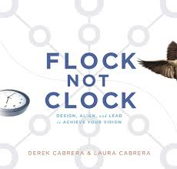
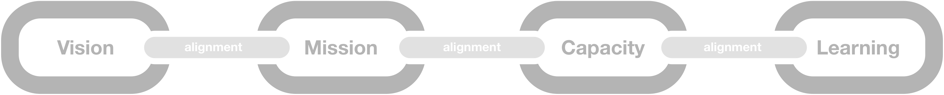
Book: Flock Not Clock: Design, Align, and Lead
Planning with a Purpose:
Vision (V) – Desired future state
Mission (M) – Repetitive actions toward vision
Capacity (C) – Mision critical systems & tools to support the vision
Learning (L) – Continuous Modifications based upon feedback
Culture (C) – Shared understanding that drives organizational behavior
Image: Cabrera Lab
Image: Cabrera Lab
Notes:
Alignment is key to the success of the methodology – Is your “Mission Moment”

Slide 11
Example: Capital Planning with Purpose
Vision: “North Star – Desired future state”
“Unified Campus Community” – Risk aware; Funding aligned with risk tolerance; consistent assessment data, prioritization, scoping and execution of a shared plan.
Mission: “Repeatable Actions towards the vision”
Assess – Asset / Program / Space
Prioritize – Consequence / Importance / Space Utilization
Scope – Resiliency (R³) (Redundant, Reliable, Recoverable)
Budget – Funding / Risk Tolerance
Execute – PM Checklist / Maximo (Workflow) TCB
Notes:
Each one of these Mission Action is a negotiation – The interest is to increase the Pie looking for win – win opportunities.
There needs to be focus on how to “Expand the Pie” vs. winning and losing. As facilities people can relate if that is the case Maintenance usually loses. the complexity lies within the relationships / the ability to .
TCB any Elvis fans out there “Taking Care of Business”

Slide 12
Example: Capital Planning with Purpose
Capacity Systems: How can capacity be produced for the mission?
Assessment System –
  Asset condition (what is wrong) , Space usage, Academic Program Viability, Key Data Sets
Prioritization System –
  Asset condition (who cares?), Space optimization, Importance to Program, Importance to University
Scoping System –
  Resiliency (R³) redundant, reliable, recoverable, Risk tolerance, life cycle costs, level of intervention 5yr, 10yr, 30yr.
Budgeting System –
  Funding (University Level, College /Unit level); Risk (University Level, College/Unit Level)
Execution System –
  Project Management Delivery “Checklists”, Contracting & Procurement, Operational (SR/WO) Application or platform
Notes:
If you zoom out a macro scale you can see “Departments” or “Divisions” within and institution.
The “Division” of Budget and Planning, the department of Facilities and Campus Services, etc….
What is it?
Tool, Application, team, process…
What are the key elements?
Key data sets, Metrics, dates, timing, people or organizations …
How will we know this “System” is working?
Key Performance indicators, milestones, feedback
Who is the driver?
Who is responsible, individual or team, interested campus steward
What is the primary artifact? (Charter)
Written documentation to reference back to realign, or adjust
Connection points, shared or influential data with other systems

Slide 13
Example: Systems of Systems (Capacity)
Key Metrics
● Building & System Assessments
● Space Usage Assessment
● Academic Program Assessments (Viability)
5-Circle System
Assessment System
● Condition
● Space Usage
● Academic Viability
● Risk
● PM Checklist
● Maximo Service Request Workflow
Execution System
Prioritization System
● Redundancy
● Reliability
● Recoverability
● Level of intervention…
● Available Funding Total Cost of Ownership
● Tolerable Risk,
Budgeting System
Scoping System

Slide 14
Example: Capital Planning with Purpose
Learning Systems: feedback loops for continual improvement
Formal Learning:
  Knowledge Management, Cross Functional Teams, Professional Development Series:
Informal Learning:
  Networking Series & Communications, Feedback on Mission Moments:
Metrics Dashboard: (Quantitative & Qualitative Measurements)
  Measuring Capacity Systems, Measuring Bridges, Measuring Learning Systems, Internal Marketing Systems, (What is the data telling us?)
Internal Marketing Systems:
  Culture Building – Sharing and promoting a common understanding Changing Mental Models
Notes:
Knowledge Management: (Library of Checklists, Templates, Guidance Documents)
Cross Functional Teams: Representatives from different departments to develop documentation for Knowledge Management Library; rotational/observation opportunities
Professional Development Series: Structured Event to share latest Template or guidance from cross functional team, or to review current operating procedures.
Professional Development/Networking Series & Communications: Networking at monthly event, Communication of mission moments
Feedback on Mission Moments: Where we have alignment and where we need improvement.

Slide 15
Example: Learning System within Execution Capacity
● Knowledge Management: Library of Checklists, templates, guidance docs.
● Cross Functional Teams: Reps from Different Dpts.
● Professional Development Series: structured event, lessons learned
Execution System
Learning System Overview
● Metrics Dashboard: Metrics from each capacity System and “Bridge”.
Metrics Dashboard
Formal Learning
● Professional Development Networking & Communications
● Feedback on Collaboration “Bridges” Mission Moments
Culture Building
Informal Learning
● Template: Progress in teaching common understanding
Key Metrics

Slide 16
“Unified Campus Community”
Example: Capital Planning with a Purpose
VMCL
Learning (L)
Capacity (C)
Mission (M)
Vision (V)
FCS’s 5-Circle System
Assess
Prioritize
Scope
Budget
Execute
Unified Campus Community
Formal Learning
Informal Learning
Assessment System
Metrics Dashboard
Execution System
Prioritization System
Culture Building
Budgeting System
Scoping System
Notes:
Don’t let the simplicity of the model fool you. As those of you in capital planning are aware of this is a very complex model, with simple rules
Unified Campus Community
[unified] Socialized Risk awareness; Funding aligned with risk tolerance, consistent assessment, prioritization, scoping and execution of socialized plan;
[Cornell] Colleges, Schools & Units
Assess Condition, space usage, and program viability
Prioritize Criticality of asset (system), High Demand College/Unit Program, Space Usage, Risk of Asset (system) failing
Scope
Purpose & Need; Intended Life Cycle, Risk Tolerance, cost estimate
Qualitative: Level of Intervention, Timing of intervention, emergent need
Quantitative: Resilient Solutions (R^3): Redundant, Reliable, Recoverable; Intended Life Cycle, Lowest Life Cycle Cost; Duration & Timing of proposed scopes
Budget Funding (Total Cost of Ownership) & Risk Tolerance
Execute PM Checklist, Maximo SR Workflow

Slide 17
Book: Flock Not Clock: Design, Align, and Lead
Planning with a Purpose:
Vision (V) – Desired future state
Mission (M) – Repetitive actions toward vision
Capacity (C) – Mision critical systems & tools to support the vision
Learning (L) – Continuous Modifications based upon feedback
Culture (C) – Shared understanding that drives organizational behavior
Image: Cabrera Lab
Image: Cabrera Lab
Notes:
Alignment is key to the success of the methodology – Is the “Mission Moment”

Slide 18
Alignment: Challenges
Bunch of Systems
Assessment System
Prioritization
System
Scoping
System
Budgeting
System
Execution
System
Mision
Notes:
Term of “Silos of Excellence”
Without a common north star or Vision
The different Capacity systems can turn inward in “Develop / Defend their Turf or kingdome
They perfect their interest, sometimes at the expense of the mission and ultimately the Vision of the institution

Slide 19
Alignment: Mission Moment – “Building a Bridge”
System of Systems
Assessment System
Prioritization
System
Scoping
System
Budgeting
System
Execution
System
Mision
Notes:
The Mission Moment is the “Bridge” between “Departments” or capacity systems that function as separate departments and reside in academics, Budget Office and in facilities.
These bridges will ensure alignment of Mission / Vision Coupling to create a “ Unified Campus Community”
Each one of these Mission Action is a negotiation – The interest is increase the Pie looking for win – win opportunities
There needs to be focus on how to “Expand the Pie” vs. winning and losing. As facilities people can relate if that is the case Maintenance usually loses. the complexity lies within the relationships / the ability to
Silos into integrated Nodes of Knowledge

Slide 20
Planning with Purpose: VMCL – C
Renewing Campus Resilience
  The vision of capital planning is not just meant for the resiliency of the campus infrastructure, but also for the resiliency of the culture of the University.
  The Culture that drives Learning renewing the Capacity systems in support of the Missions to achieve the Vision.
  The “Mission Moments” or bridges between our departments (or capacity systems) will promote curiosity and drive progress toward your Vision.

Slide 21

Discussion:
Andrew M. Germain, PE, CEFP, EMBA ’27
Cornell University
amg96@cornell.edu

